Slide 1



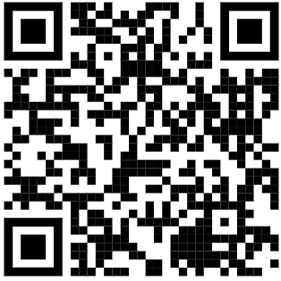
Are you interested in taking part in research?
Does your baby have a permanent hearing loss in both ears?
Is your baby under 7 months old?
The research team in Manchester are attempting to develop a new test for babies with hearing loss
Ask your Audiologist for more details!
Or get in touch using the details below
Improving clinical practice for babies with hearing loss, IRAS 172044
Email: mft.babyhearingstudy@nhs.net
Phone: 0161 306 1754 / 07543 228 856
Facebook: Ladies in the Van
Twitter: @ladiesinthevan
Recruitment poster: Improving clinical practice for babies with hearing loss (03 June 2019, V1.0)

