Slide 1
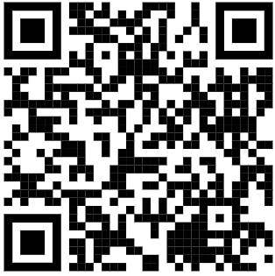
Improving clinical practice for babies with hearing loss
Inclusion criteria | Exclusion criteria
(i) Infant aged under 7 months (corrected age) at start of study. (ii) Diagnosed with permanent bilateral hearing loss of any degree or type. (iii) Fitted with hearing aids by the start of the study (it’s fine to introduce the study beforehand). | (i) Developmental delay that would likely significantly delay behavioural assessment (VRA) (ii) Caregiver accompanying infant has physical disabilities that cause them to be unable to step up into the Mobile Research Unit which is not wheelchair accessible.
Improving clinical practice for babies with hearing loss, IRAS 172044
Email: mft.babyhearingstudy@nhs.net
Phone: 0161 306 1754 / 07543 228 856
Facebook: Ladies in the van
Twitter: @ladiesinthevan
Professional poster: Improving clinical practice for babies with hearing loss (03 June 2019, V1.0)

