Slide 1

My Future
Northern Ireland

Slide 2
1. Introduction

Slide 3

Who is here today?
Presenters
Participants:
Your name
How old you are
How do you
communicate
Support
people
Notes:
Introduce yourself and any other adults in the room, especially if the group is not usually together or those in the room are unknown
You can have participants also introduce themselves
If the group is well known to each other or you are delivering this as a 1-1 support session, this slide can be deleted

Slide 4
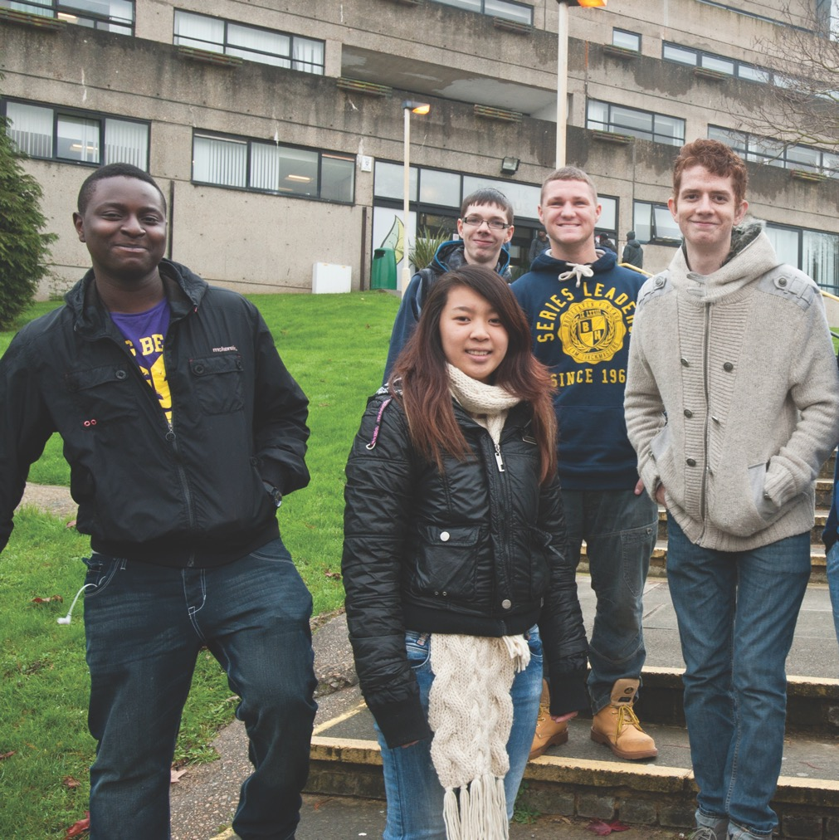
What is the
My Future workshop?
The options available to you
when you leave school
The support available to you
when you are studying or working
Recognising your own skills
and interests

Slide 5
My Future session –
8 parts
Introductions and Icebreakers (LP1)
Own your deafness (LP2)
Your rights (LP3)
Career hopes and dreams (LP4)
Build your brand (LP5)
Post-16 options (LP6)
Support and technology (LP7)
Careers action planning (LP8)
Notes:
LP = Lesson plan

Slide 6
Ground Rules
Housekeeping
Put your hand up to talk
Speak one at a time
Support each other
Make sure everyone can see you
Be open and honest
Have fun!
Notes:
Suggested ground rules, you can use these or have the group come up with their own

Slide 7

Icebreaker! Group activity
Choose:
Number Game (13-16 years) (R 1.1)
Job names (13 -25 years) (R 1.2)
Post-its game (13-25 years)
Human Bingo (13-25 years) (R 1.3)
Your own!
Notes:
Refer to toolkit for lesson plans
You can also use an icebreaker you know of that works well for your group

Slide 8




Before we start – Your views
What do you think about your career options?
Only a few jobs
are suitable for me
Some jobs
are suitable for me
Most jobs
are suitable for me
All jobs
are suitable for me
Notes:
Ensure trainer does not lead this by suggesting which jar they would choose
Useful as a baseline comparative figure

Slide 9



Before we start – Your views
Do you know what the Access to Work scheme is?
Do you know what Disabled Students’ Allowances are?
Do you know what rights you have as a deaf young person under the Equality Act?
I know about it and know what support I could get
I have heard about it, but don’t know what I could get
I don’t know anything
Notes:
Use show of hands, groups standing around the room – whatever works for you
Useful as a baseline comparative figure

Slide 10


Have you thought of a job
you would you like to do?
These questions may help you think of options:
What did
I want to be
as a kid?
What
makes me happiest?
What subjects do I like?
Don’t worry if you are not sure yet!
Notes:
Prompt questions – what did you want to be when you were a kid? Is that still the same? Has it changed? What do you want to be now?

Slide 11
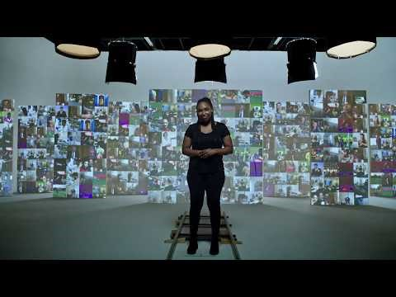
Deaf Works Everywhere
Notes:
Video can be embedded but is too large. Hyperlink instead.

Slide 12
2. Own your
deafness

Slide 13
Own your deafness
What do we mean by this?
Knowing about your deafness, level/type
Knowing who you are
Knowing how you communicate
Knowing what support you require
Being confident and proud to tell people
you’re deaf
Notes:
These next three slides 13-15 can be switched around very easily into whatever order you feel works best

Slide 14
Why own your deafness?
Being deaf is part of your identity
Telling other people can help you
If you don’t tell people you’re deaf
it is hard for them to know how to
help you
Be confident about the support you
need – never be worried to ask!
Having support can make you
feel more confident in making
a positive difference
Knowing this can help you
with planning your future

Slide 15
Activity –
Positives and Challenges
The challenges of being a deaf young person
Hobbies
Sports
Friends
Family
Home
Travel
School
Communication
The best things about being a deaf young person
Notes:
For quiet groups – use a ball, use coloured post its that are put up and read out by the trainer, ask for two positives and one challenge from everyone/from a small group
How can the challenges be a positive? E.g. there is a challenge when an interpreter doesn’t show up, but by finding another way to communicate, I show myself to be adaptable and resilient

Slide 16
3. Your rights

Slide 17
Disability Discrimination Act and the Disability Discrimination (Northern Ireland) Order 2006
You have the right not to be discriminated against because of a disability, this includes deafness
Important to be aware of this
Businesses and public services must follow the Act (schools, colleges, hospitals, shops, employers)
‘Reasonable adjustments’; simple changes
to make sure deaf people are not excluded
Notes:
Trainer to ensure they cover what “discrimination” means and cover what reasonable adjustments could be made (e.g. employer communicates with you by email rather than phone or college lecturer faces you at all times when speaking)

Slide 18
Special Education Needs
If you’re assessed as having a Special Educational Need (SEN), you have the right :
to a personal learning plan that takes your views into account;
to make an appeal about the help you are offered;
In further education or college, you can have your needs assessed by a Learning Support Officer or Disability Officer to make sure you are not disadvantaged in accessing education.

Slide 19

Skills to Succeed identifies which skills NI employers want, and helps you to develop abilities that will make you more employable, through:
Careers Advice
Essential Skills Courses
Training Courses
Further and Higher Education
Apprenticeships
See https://www.nidirect.gov.uk/campaigns/
skills-succeed
Notes:
Trainer to note this is not an additional right in law like the Acts mentioned previously, but is good scheme to be aware of when leaving school.

Slide 20
Are the following
True or False?
Myth busting quiz!
Myth busting quiz!

Slide 21
1. Once I leave school I won’t get any more help or support with my deafness.
False
2. I won’t be able to go to university because I’ll struggle to hear the teacher during lectures.
False
3. I won’t be able to do the same jobs as my hearing friends because I’m deaf.
False
4. If I get a job interview I should tell the employer that I’m deaf before the interview.
True
5. I won’t be able to get a job in an office because I’ll find it too difficult to take part in discussion during meetings.
False
6. When I have a job and I want to use Access to Work funding, my employer will sort this out for me.
False
7. If my employer has paid for reasonable adjustments at work then they can pay me a lower salary.
False
8. Deaf people can fly aeroplanes.
True
9. Some deaf people are able to get a job in the Army or as a police officer.
True But you will have to have a medical test including hearing check
10. Some deaf people can’t work on sea-faring ships, for example on cruise ships.
True What?

Slide 22
Break

Slide 23
4. Career hopes
and dreams

Slide 24
What’s the difference?
What’s the difference?
Strengths
Interests
Personality

Slide 25
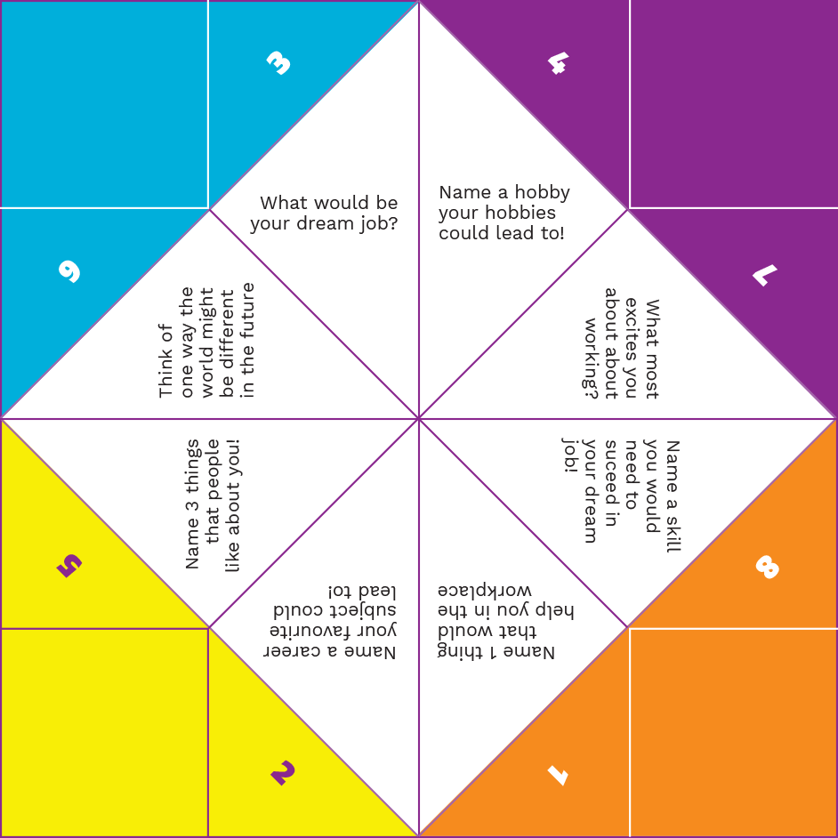
Activity
Choose:
Strengths
Interests
Personality
Strengths, Interests
and Personality
Chatterbox
Notes:
Choose an activity that suits the age and skill level of your group, or run both!

Slide 26
Healthcare
Science and Research
Construction and
Trades
Business, Finance and Administration
Sports and Leisure
Retail and Sales
Social Care
Engineering and Maintenance
Home Services
Law and Legal
Travel and Tourism
Beauty and Wellbeing
Creative,
Media and
Communications
Computing, Technology and Digital
Delivery and Storage
Managerial and People Services
Environment and Land
Hospitality and Food
Teaching and Education
Manufacturing
Transport and Logistics
Government Services
Animal Care
Freelancing and Self-Employed
Source: National Careers Service – Explore Careers
Notes:
Broad areas of work taken from National Careers Service
Can use this OR next three slides
Use with resource page

Slide 27
Healthcare | Social Care | Creative, Media and Communications | Teaching and Education
Dentist Nurse Midwife GP / Doctor Consultant Speech and Language Therapist Ambulance Crew | Social Care Worker Youth Worker Therapist / Counsellor Life Coach Nanny | Journalist Public Relations Marketing Presenter Graphic Designer Photographer Advertising Dressmaker | Teacher Teaching Assistant Teacher of the Deaf University Lecturer Librarian Nursery Worker Training Officer
Science and Research | Engineering and Maintenance | Computing, Technology and Digital | Manufacturing
Scientist Researcher Statistician Astronomer Biologist Climate scientist Fingerprint Officer Meteorologist Pathologist | Mechanical Engineer Auto Electrician Boat Builder Building Site inspector Civil Engineer Electrician Lift Engineer Model Maker | IT Officer Website Developer App Developer Software Developer Computer Games Tester IT Trainer Systems Analyst Vlogger | 3D Printing technician Bottler Car manufacturing worker Packer Food packaging operative Sign maker
Notes:
If using here, don’t spend a lot of time – ask the group if any stand out, if they have heard of any, if they haven’t heard of any
Try to at least mention the industry for the next case study slides

Slide 28
Construction and Trades | Home Services | Delivery and Storage | Transport and Logistics
Carpenter Joiner Plumber Brick layer Surveyor Architect Structural Engineer Town planner Painter and Decorator | Handyperson Bin Worker Janitor / Cleaner Dry Cleaner Pest Control Tailor Wedding planner Interior Designer | Airport baggage handler Courier Delivery Driver Removals worker Roadie Warehouse Worker | Train / Bus driver Pilot Large Goods Vehicle Driver Shipping / Postal Service Taxi Driver / Uber Driver
Business, Finance and Administration | Law and Legal | Managerial and People Services | Government Services
Accountant Financial Adviser Business owner Mortgage adviser Bank Clerk Project Manager Administrator Payroll officer | Company / Legal Secretary Coroner Equalities officer Family mediator Paralegal Solicitor | Business Development Officer Contracts manager Events manager Franchise owner HR adviser MP Office manager Supervisor | Careers adviser Gravedigger Environmental Health Officer Heritage Officer Immigration services Museum Assistant Registrar

Slide 29
Sports and Leisure | Travel and Tourism | Environment and Land |  | Animal Care
Athlete Sports Coach Cinema projectionist Fairground worker Leisure centre assistant Personal trainer Resort representative | Hotel services Housekeeper Tour manager Tour guide Travel agent | Archaeologist Botanist Cartographer Ecologist Farmer Florist | Forestry Worker Gardener Landscaper Palaeontologist | Animal care worker Zoologist Zookeeper Beekeeper | Dog Groomer Dog Walker Horse groom RSPCA inspector Vet
Retail and Sales | Beauty and Wellbeing | Hospitality and Food |  | Freelancing and Self-Employed
Antique Dealer Bar person Shop assistant Barista Butcher Customer services assistant Letting Agent Personal shopper Shelf stacker Vending machine operator | Aromatherapist Art therapist Barber / Hairdresser Massage therapist Make-up artist Reiki healer Tattooist | Cake decorator Catering assistant Baker Chef Fishmonger Food scientist Kitchen assistant Waiter |  | You can work freelance or be self-employed in many of the areas we’ve shown you!

Slide 30
Deaf or Hearing?
Teaching Assistant and Foster Carer
E, Pontypool
Agency Sales Executive for C4
C, Manchester
A&E Doctor
B, Midlands
Teaching and Education
Creative,
Media and
Communications
Healthcare
Severely deaf
2 hearing aids
Profoundly deaf
1 hearing aid
Moderately deaf
Two hearing aids
Notes:
As the students if they Can match each person with an industry from the previous slides/handout resource ?

Slide 31
Which person is Hearing?
Trick question!
They are all deaf!
Photographer
L, London
Company Owner
T, London
IT at Ministry of Defence
Y, London
Statistician
C, Edinburgh
Creative,
Media and
Communications
Business,
Finance and Administration
Computing, Technology and Digital
Science and Research
Profoundly deaf
1 Cochlear implant
Profoundly deaf
2 Cochlear implants
Profoundly deaf
No hearing devices
Profoundly deaf
Two hearing aids
Notes:
As the students if they Can match each person with an industry from the previous slides/handout resource ?

Slide 32
Final round…Hearing or Deaf?
Joiner and business owner
F, West Lothian
Uber driver
O London
Remember these nine people… We will look at their work journey and any support they use in the workplace later!
Construction and Trades
Transport and Logistics
Profoundly deaf
1 cochlear implant
Profoundly deaf
No hearing devices
Notes:
As the students if they Can match each person with an industry from the previous slides/handout resource ?

Slide 33
5. Building
My Brand

Slide 34
Activity
Choose one:
Build a giraffe (13-16 years) (Newspapers)
Build a tower (16-25 years) (Skewers)
Experience Counts (16-25 years) (R5.1)
Notes:
Can change activity or use different materials – build a tower, build a bridge etc

Slide 35
Skill-sets
Soft skills | Hard Skills
Are character traits | Can be taught and measured
Linked to your personality | Linked to ability or capability to do something
Self-developed | Self-learned
General | Specific
Both can come from your interests and strengths
Both can be developed and improved
Employers are looking for both!

Slide 36
What do employers want?
Soft skills
Problem solving
Positive attitude
Teamwork
Communication skills
Time management
Working under pressure
Leadership
Perseverance
Adaptability
AND MORE!
Hard Skills
Your qualifications
Language skills
Typing speed
Using Excel, Word
Using a machine
Driving
Using specific systems
Operating a computer
Other technical knowledge
AND MORE!
Employers look for both
types of skills
Knowing what your skills
are can help you decide
your career
You need to think of examples of your skills and how you
use them for your college,
uni and job applications and interviews – and practice them!

Slide 37
Break

Slide 38
6. Post-16
options

Slide 39

Going on a journey
Imagine that you were going on a school trip tomorrow?!
Could you do it?

Slide 40
What should I pack?
Where will I stay?
Where do I want to go?
Is my passport in date?
?
Stressful!
Today
Departure tomorrow
How much can I spend?
How will I get to the airport?
Do I need a visa?
What do I want to do there?
Notes:
Make the point – that within 24 hours, this is a lot of decisions to make, the decisions will be rushed, not thought out, and may not be possible

Slide 41

Your Career Journey
You need time to plan and consider your options – don’t leave it until the last minute.
The earlier you start planning for your career,
the more options you’ll have.
Your future
Consider your options
Communication support
What do I need help with?
Choose your subjects
What do I enjoy doing?
What am I good at?
Today
Set goals

Slide 42

Your Career Journey
is the same
What options
do you have?
You need to know:
Where you want to go
Which steps you need to take to get there
How much time you have
What you might be interested in
What skills you have

Slide 43

Sixth form – stay on at school
Can be part of the same school
Usually leads to A-levels
Fewer options than college
Can be a starting point for university

Slide 44

College
New place of learning / feels different
from school
Academic, vocational and technical courses
Lots of options

Slide 45

Work experience
First step into workplace
Helps you to understand the job
Usually not paid (only expenses)
Great way to develop your skills
You get to meet lots of people
Notes:
Resources for students –
https://www.nijobfinder.co.uk/
https://www.jobcentreonline.com/JCOLFront/Home.aspx
https://www.communityni.org/job

Slide 46

Apprenticeships
On the job training – you get paid
Usually minimum of 2 years up to 4 years
You study 1 day a week (usually at college)
Sometimes you’ll get a permanent job at the end
Over 100 options
You will need to look for an apprenticeship in a similar way to looking for a job: https://www.nidirect.gov.uk/services/search-apprenticeship-opportunities
You can also get support from
the Apprenticeship Helpline:
Apprenticeships@economy-ni.gov.uk
Freephone Text Number 0800 3280 824

Slide 47
Traineeships
Higher Level Apprenticeships are also available
You must have completed A Levels or equivalent
Lasts minimum 2 years
Paid to work and study
You can achieve professional-level qualifications without paying higher education fees
More information available online: https://www.nidirect.gov.uk/articles/
higher-level-apprenticeships

Slide 48
Internships
Traineeships and Internships do not
run in Northern Ireland as official Government programmes
However, should you be interested
or move one day, you might like
to remember their names!

Slide 49


University
Higher level education
Get a degree by studying
a specific subject
For some careers you need a degree
Have to apply through:
Universities and College
Admission Service

Slide 50

Employment
Paid job
Full-time or part-time
It doesn’t have to be a ‘job for life’
You can still study whilst working
Public, private or charity sectors
Notes:
Resources for students –
https://www.nijobfinder.co.uk/
https://www.jobcentreonline.com/JCOLFront/Home.aspx
https://www.communityni.org/job

Slide 51

Volunteering
Great to show on your CV
Gain valuable experience
and learn new skills
Can be really rewarding and fun
You can volunteer abroad too!
Notes:
Resources
https://www.volunteernow.co.uk/
https://www.communityni.org/job (volunteer filter)

Slide 52

Activity
Put the illustrations on the floor
Use the footprints to connect them
Ask the young people to choose
what they think they will do next
Then what is their next step?

Slide 53
Another option is…
Travelling / Gap year
Travel the world
Do volunteering work
Learn new cultures and visit landmarks
Learn new skills
Achieve personal challenges
Notes:
Can volunteer overseas as well with programmes for smaller fees. See globalteer.org

Slide 54




Australia
Egypt
France
China

Slide 55




Italy
USA
India
Peru

Slide 56
Real examples
(more at the end!)
B, Midlands
Consultant
L, London
Freelance photographer
Moderately deaf
Two hearing aids
Profoundly deaf
1 Cochlear implant
Junior doctor –
10 years!
Work
experience
Medicine at uni –
6 years!
Photography
degree at uni
Travelling
Science A-levels
GCSEs and A-levels
Science GCSEs

Slide 57
Careers quiz!
1. What is not a reasonable adjustment?
Having an interpreter provided if you need one Being paid more than your colleagues for doing the same job Subtitles for presentations, videos or speeches Having a radio aid
4. In 1914, what was the most popular apprenticeship?
Cooking Engineering Animal Work Dressmaking
5. In 2014, what was the most popular apprenticeship?
Health and Social Care Engineering Animal Work Hairdressing
2. What age do you have to start university by?
18-21 21-30 30-50 Any age!
6. Which skills do employers find the most valuable?
Communication Team work Time management Problem solving
3. Who applies for Access to Work?
Your employer Your parents You Your manager
All of them!
Sorry, trick question!
Notes:
Do this as a group – display the question and the options, then get the group to shout out which answer they think it is before showing the answer

Slide 58
7. Support
and technology

Slide 59
Activity –
communication support
Match the name to the correct image!
Extra time – 25% |  | Lip-speaker
Teacher of the Deaf |  | Agenda or transcript
Speech to Text Relay (STTR) |  | British Sign Language Interpreter
Phone Amplifier |  | Communication Support Worker (CSW)
Subtitles |  | Notetaker (Written – Electronic)
Deaf Awareness Training |  | Radio Aid

Slide 60


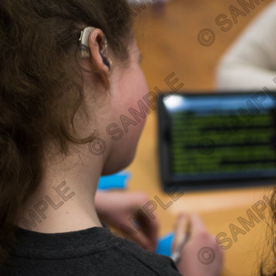



Extra time
Teacher of
the deaf
Speech to Text Relay (STTR)
Lip-speaker
Agenda
British Sign Language Interpreter

Slide 61
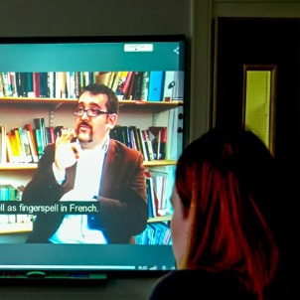

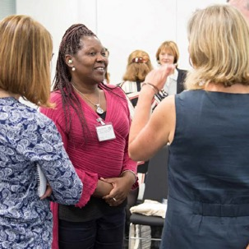
Phone amplifier
Communication support worker (CSW)
Subtitles
Notetaker
Deaf awareness training
Radio Aid

Slide 62
DSA (Disabled Students Allowance)
Pays for support in Higher Education (university)
You can use it to buy a piece of technology
or to pay for communication support
You have to apply for it online as part of a Student Finance Application (www.studentfinanceni.co.uk)

Slide 63
ATW (Access to Work)
A UK government scheme for employees who are deaf or disabled
Provides funding to pay for support in the workplace including apprenticeships, traineeships and supported internships
The funding is capped and budgeting is needed to manage your funding
You have to apply for this yourself – online via the Department for Communities (nidirect.gov.uk website)

Slide 64
Technology quiz!
1. I can’t be a doctor or nurse because I can’t listen to people’s heartbeats with a stethoscope.
False
2. A deaf person can be a police officer by using an adapted radio for radio communication.
True
3. Radio aids help you hear like hearing people.
False
4. I can’t hear well in groups of people so I can’t be a teacher.
False
5. A deaf person can work on a construction site and be alerted to a fire alarm with an adapted device.
True

Slide 65
Scenario Activity
Split the group into smaller groups
Give each group a scenario
Ask them to think about which support
options can be used in each scenario
Present feedback

Slide 66
Remember the faces?
How does everything we’ve shown you today work in the real world?
What support do people use?
What was their education and career journey?
What tips can they give you?

Slide 67
A&E Doctor
B, Midlands
Consultant
Technology @ work
Electronic stethoscope.
Direct input leads for smartphone.
Moderately deaf
Two hearing aids
Tips for deaf young people
Think about what you love doing.
All jobs are challenging sometimes. Enjoying what you do will help you through the difficulties.
Junior doctor –
10 years!
Medicine at uni –
6 years!
Science A-levels
Science GCSEs

Slide 68
Photographer
L, London
Freelance photographer
Technology @ work
None at work – but uses hearing
loop in theatres and cinemas.
Profoundly deaf
1 Cochlear implant
Tips for deaf young people
Never be afraid to ask for help
– it goes a long way and will
help you reach your targets.
Work
experience
Photography
degree at uni
Travelling
GCSEs and A-levels

Slide 69
Teaching Assistant
and Foster Carer
E, Pontypool
Level 3 Teaching Assistant
Technology @ work
Roger Pen, Telephone adapter.
Deaf awareness training for school staff.
Severely deaf
2 hearing aids
Tips for deaf young people
Be positive and don't give up.
There is a dream job for everyone out there. It's all possible with the right attitude and support.
Adult
education
Failed exams
at school –
hearing loss
not diagnosed

Slide 70
Agency Sales Executive
C, Manchester
Agency Sales Executive
Technology @ work
Telephone adapter.
Profoundly deaf
1 hearing aid
Tips for deaf young people
Have honest conversations
with your employer about
any challenges you face.
Everyone is different!
Worked my way up
Applied for Apprenticeship
at Channel 4
Worked in my local shop
Left school at 16

Slide 71
Director of her own company
T, London
Director
of a captioning company
Technology @ work
Uses Access to Work to pay for palantypists and lip speakers.
Vibrating pager for the
fire alarm.
Profoundly deaf
2 Cochlear implants
Trained as a
lipreading mentor
Tips for deaf young people
Think through your career options. Make sure you know the resources and technology that are available and ask Access to Work for support.
Post-graduate degree in Careers Guidance
Post-graduate degree in Law
Degree in Business and Japanese

Slide 72
IT for the Ministry of Defence
Y, London
Job at
MoD
Technology @ work
Uses Access to Work to pay for BSL interpreters and notetakers.
Profoundly deaf
No hearing aids
Unemployed for
a long time
Work experience at a big US corporation
Degree in IT
Interested in computers since age 13

Slide 73
Statistician
C, Edinburgh
Statistician
Technology @ work
Uses Access to work to pay for
Roger Pen.
Voice recorder to record meetings.
Profoundly deaf
Two hearing aids
Tips for deaf young people
Know your rights as a disabled worker and apply for Access to Work as soon as you can as it can take
a while to go through.
Applied for permanent position
Work experience
as Researcher
MA in Applied Social Research
Maths and Computer
Science at uni

Slide 74
Joiner and business owner
F West Lothian
Runs his
own company
Technology @ work
Deaf awareness training
for colleagues.
Vibrating fire alarm pager.
Profoundly deaf
1 cochlear implant
Tips for deaf young people
I've learned loads in my apprenticeship, and I’d advise anyone to give it a go.
Apprentice Joiner
(for 4 years)
Age 16, applied
for apprenticeship
Enjoyed woodwork
at school

Slide 75
Uber Driver
O, London
Uber driver
Technology @ work
Uber app – new ride requests flash up and passengers can text me.
Profoundly deaf
No hearing devices
Tips for deaf young people
Be confident and show what you can do.
There’s lots of technology out there which
can make jobs easier for you!
Passed
driving test
College
Foundation Art
BTEC level 3
architecture

Slide 76


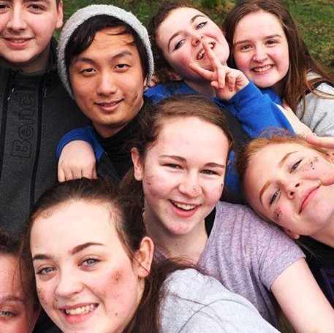
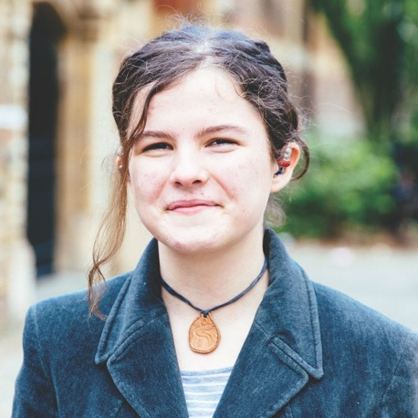
With the right support, deaf people can do loads of jobs!
It’s your future!

Slide 77
8. Careers
Action Plan

Slide 78
What is action planning?
Helps you to focus your thoughts and ideas into a series of steps to achieve your career aims within a certain timeframe
Can change as you research and get
more ideas
You can change this at any time after today, but using an action plan will help you to know what to focus on next.

Slide 79
Create your own action plan
Ready
Set
Go
Notes:
Use R8.1

Slide 80
Reflect
and Go

Slide 81
Well done you!
Well done! You’ve taken part in our workshop!
Give the person next to you a high five!
Any questions?
Evaluation

